Slide 1
Intro to WebGL for Visualization
Northwestern University
Computational Research Day 2018
Download the Project files from:
github.com/nuitrcs/IntroToWebGLWorkshop

Slide 2
Test Your Browser
get.webgl.org

Slide 3
Michael Cronin
Northwestern University
Interactive Data Visualization Specialist
michael.cronin@northwestern.edu

Slide 4
Topics
3D Fundamentals
What is WebGL?
Creating an interactive Visualization with WebGL

Slide 5
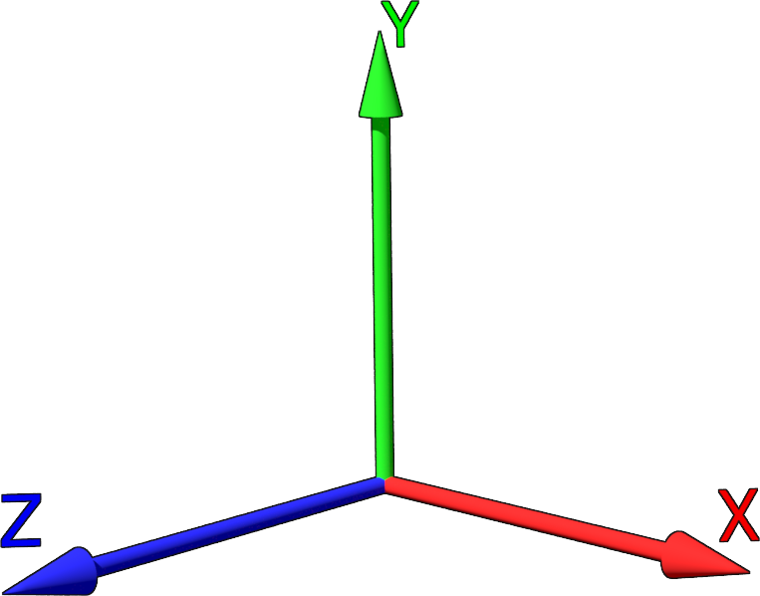
What is 3D?
A representation or model of data
on three axes usually representing width, length and height
(often over a time interval)

Slide 6
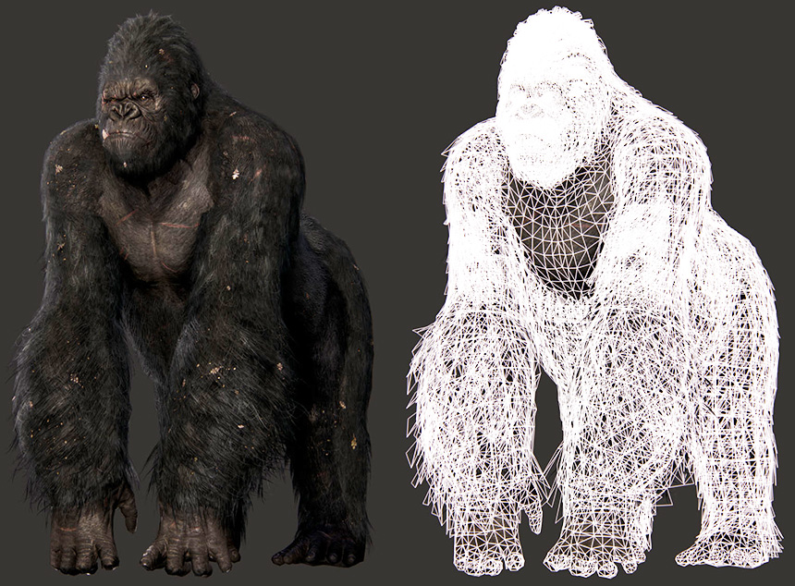
The ubiquity of 3D graphics and animation in films and games has made the technology accessible and attractive to leverage in Research and Academia

Slide 7
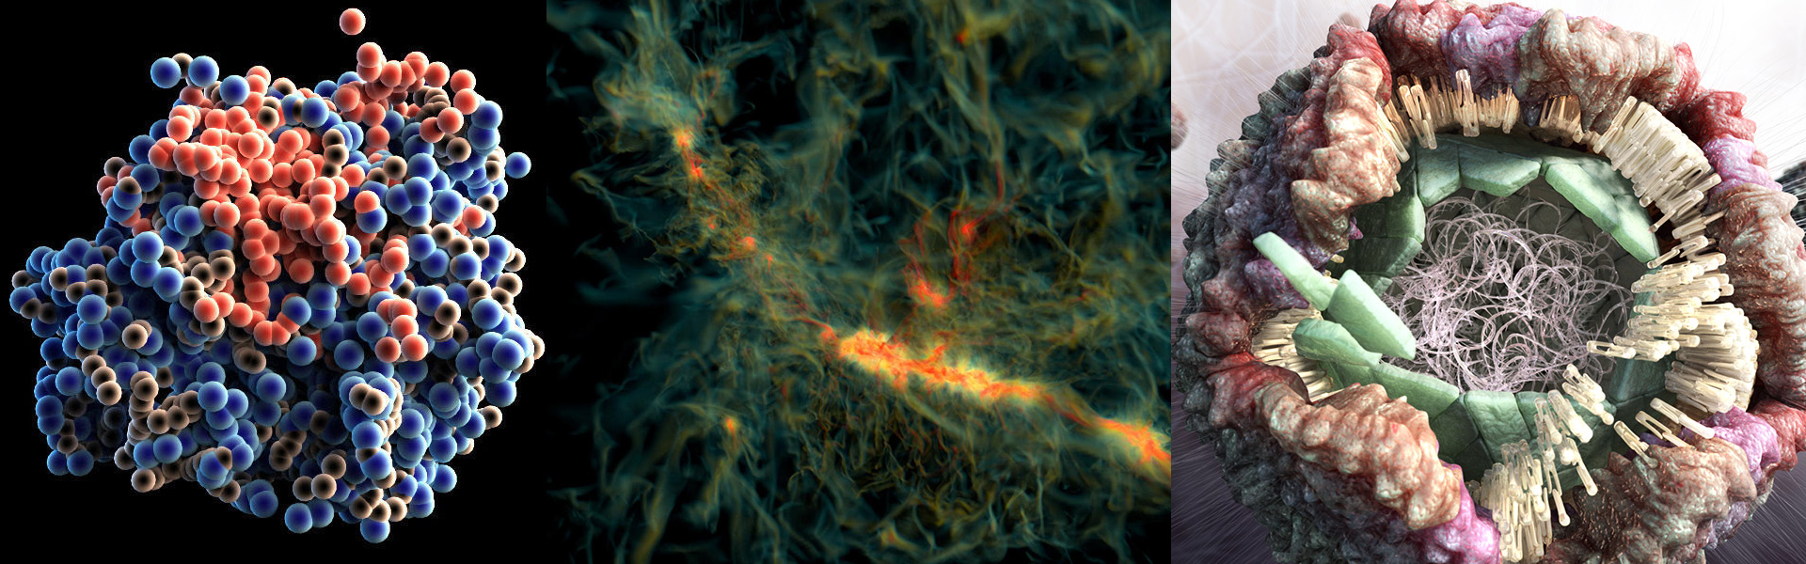
Research and Academia
Physical Sciences make extensive use of 3D for illustrations

Slide 8
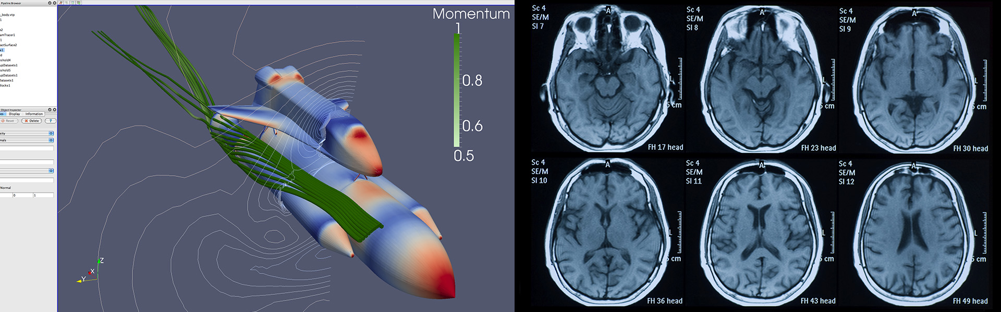
Research and Academia
Software and Instruments generate 3D images and animation

Slide 9
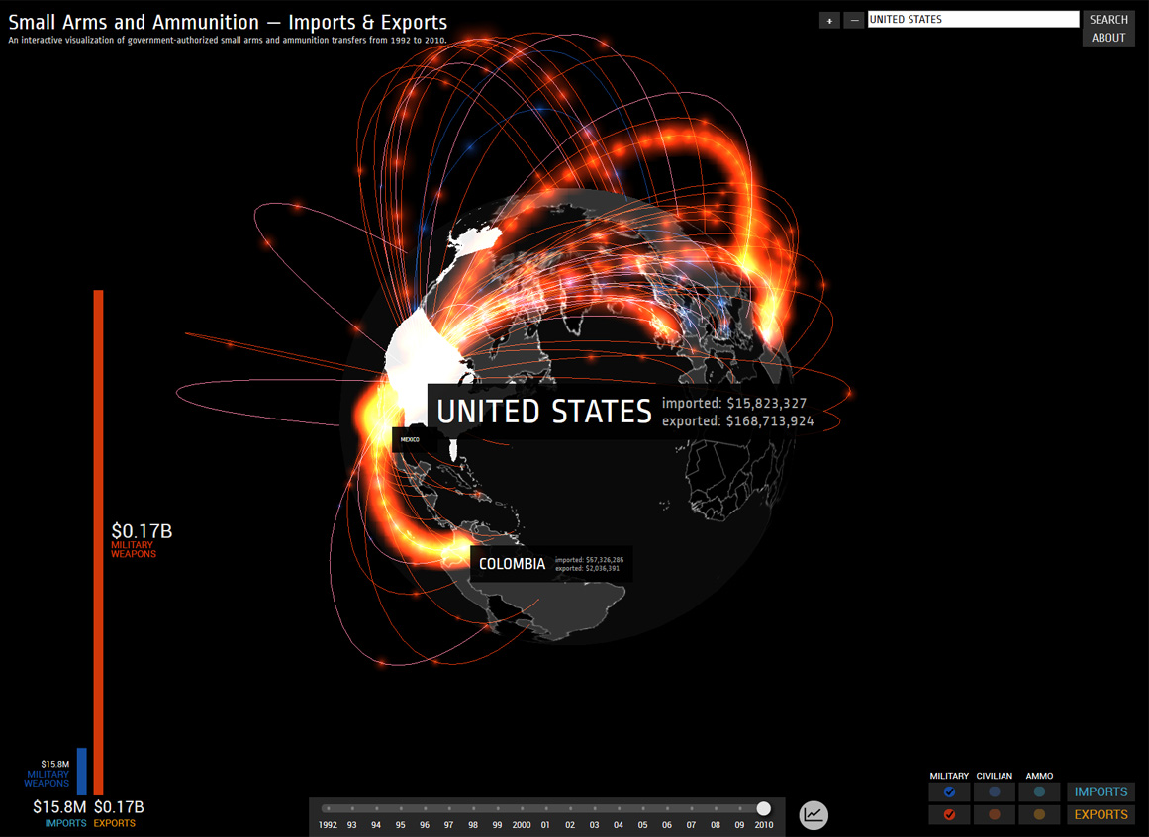
3D visualizations can clearly communicate data that traditionally would be presented in a spreadsheet, graph or chart

Slide 10
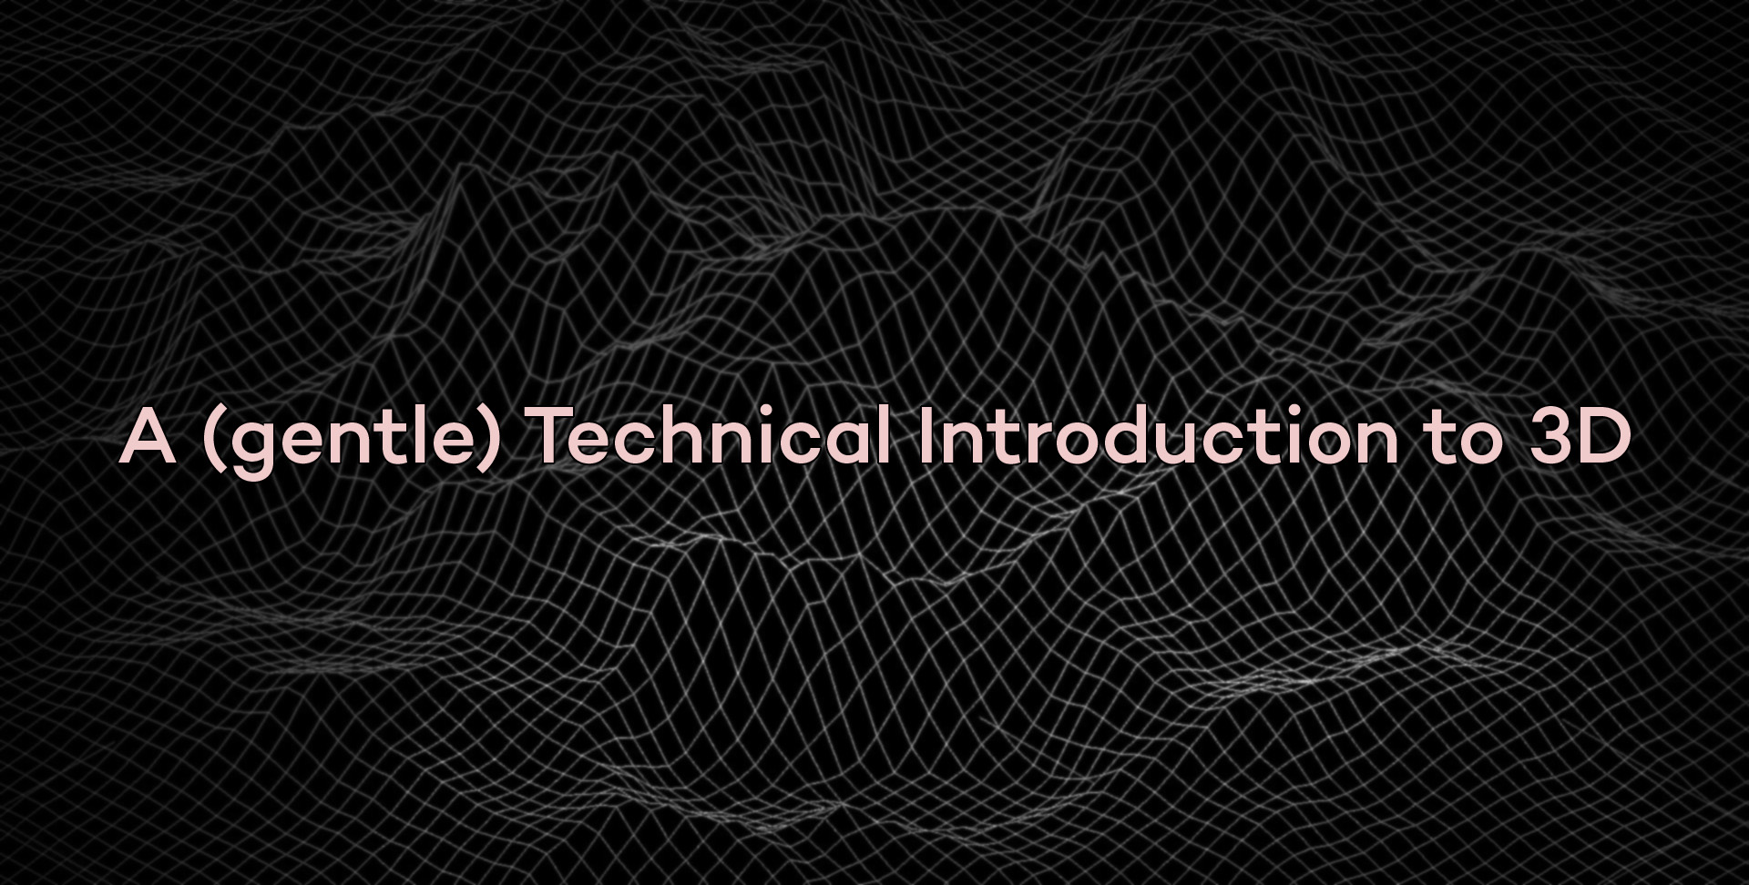

Slide 11
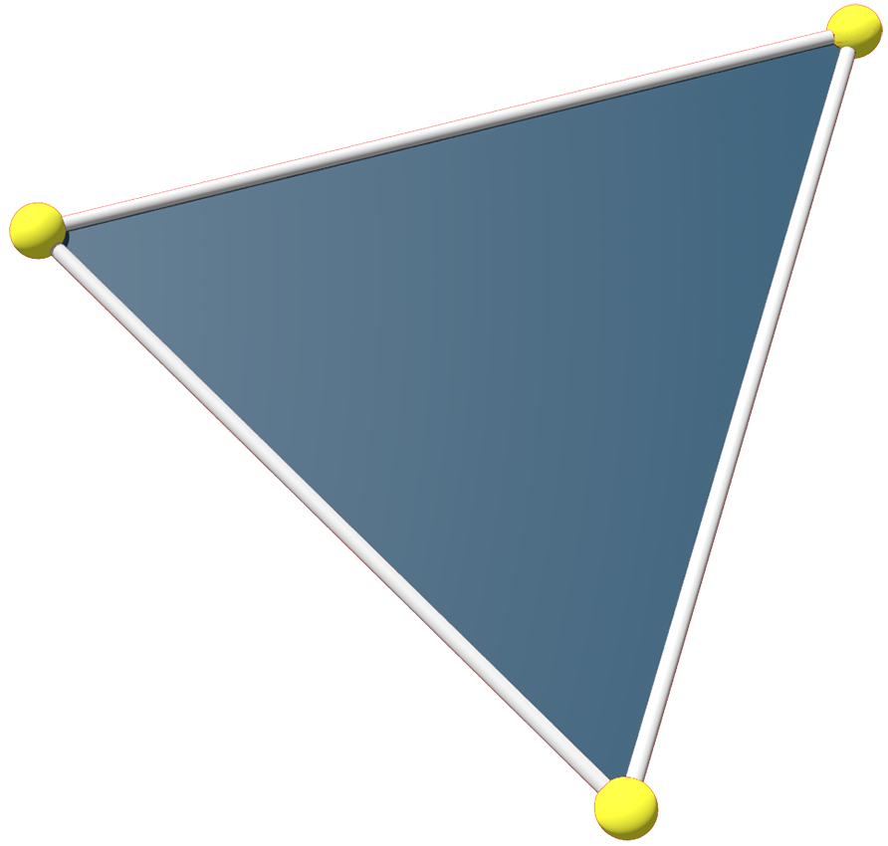
Triangles, the atoms of 3D
Defined by three point positions called vertices (singular: vertex)
Most simple shape that can be defined in three dimensions
Always planar
Easy to quantify relationships (thanks Euclid and Pythagoras!)

Slide 12
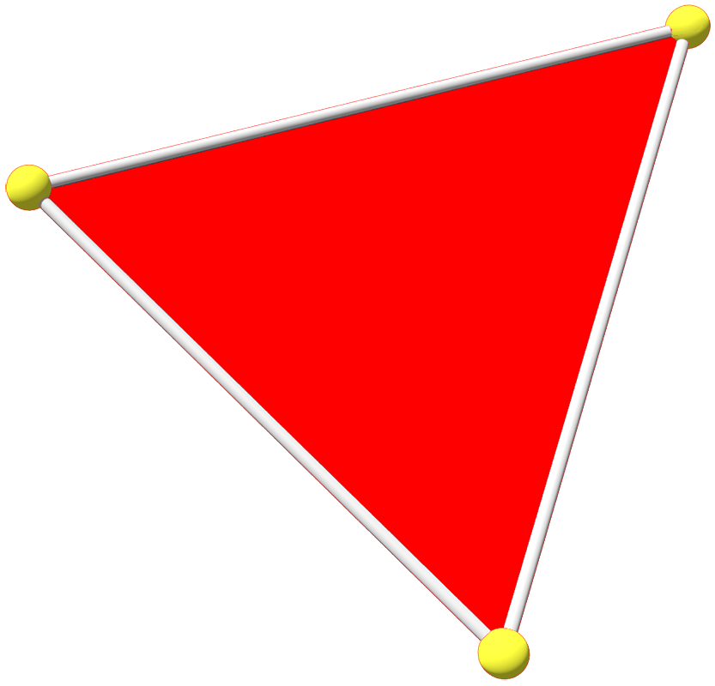
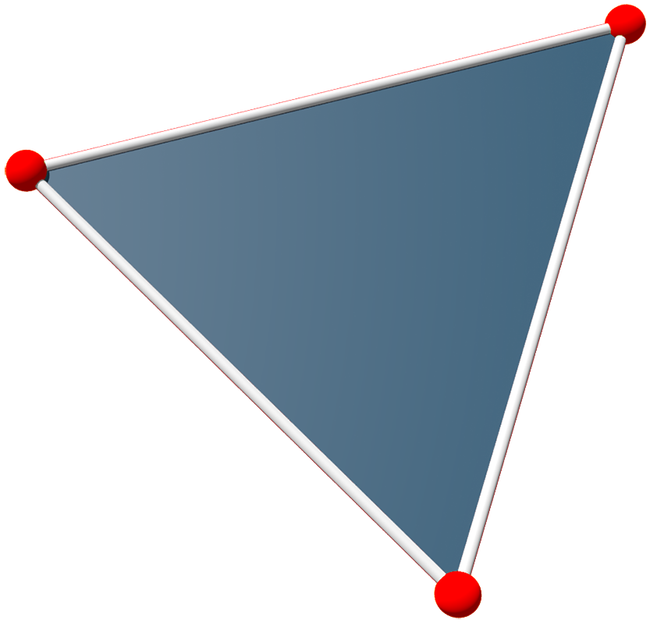
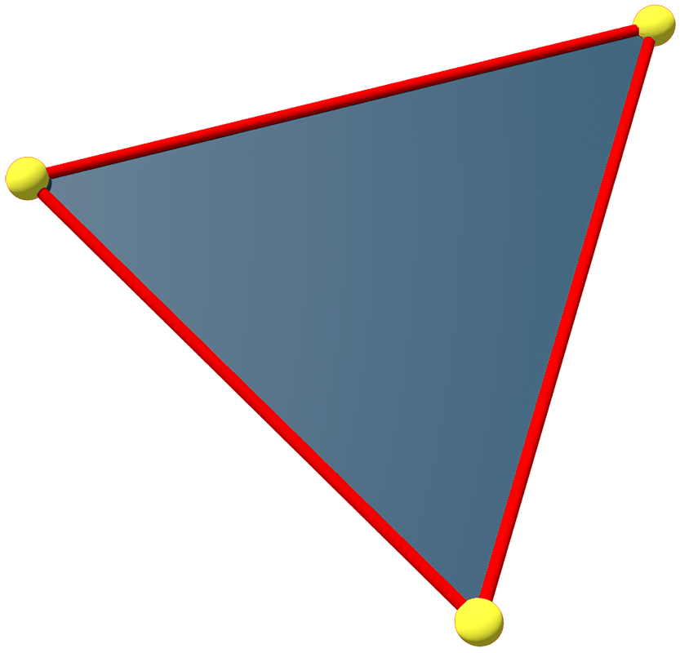
Components of a Triangle
Vertex
Edge
Face

Slide 13
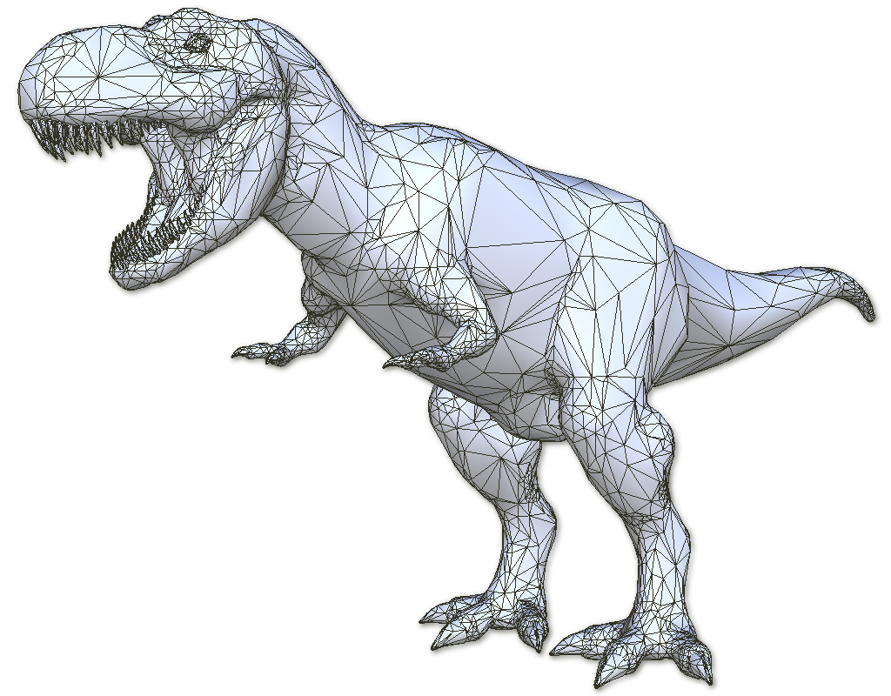
Adjacent triangles can be defined by adding a single vertex for each additional triangle
Many adjacent triangles define a model

Slide 14
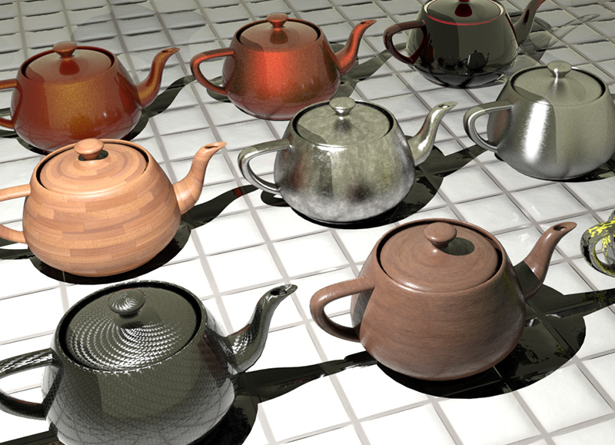
Materials applied to models give an object a desired appearance
The combination of Model and Materials is called a Mesh

Slide 15
Materials are comprised of textures (2D images), and one or more Shader Programs

Slide 16
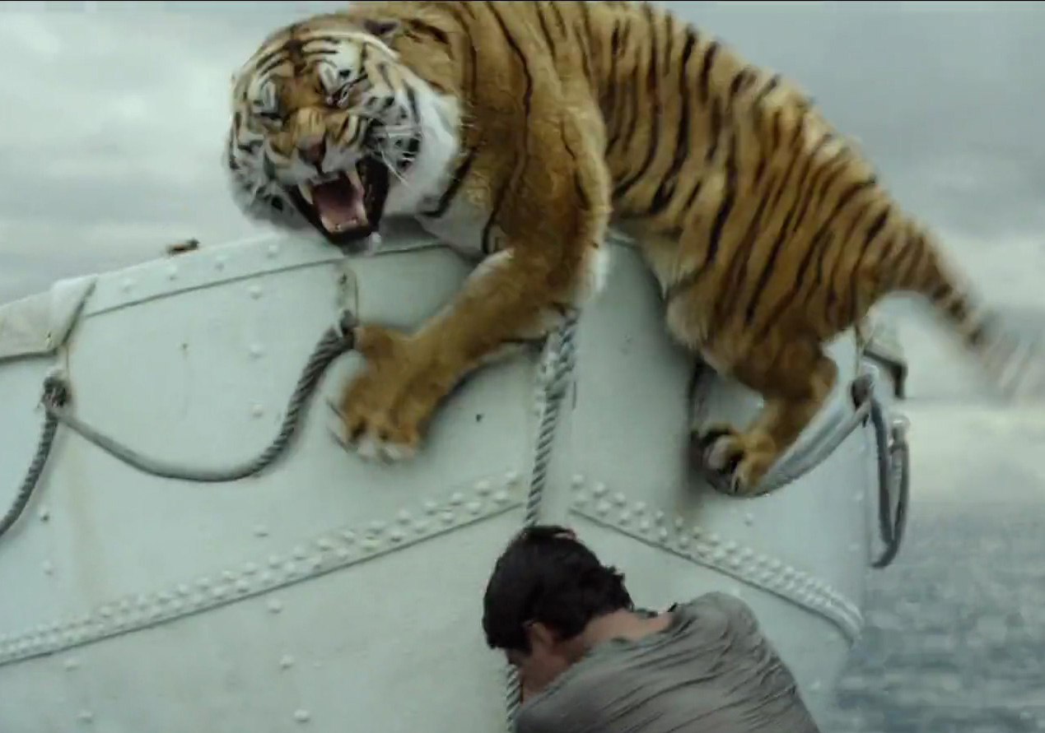
The tiger’s fur has millions of strands generated by a Shader Program
Shader Programs have two components: a Vertex Shader and a Fragment Shader

Slide 17
The Vertex Shader places and deforms all the points that make up the strands of fur on the tiger

Slide 18
The Fragment Shader determines the final color and opacity of each strand of fur

Slide 19
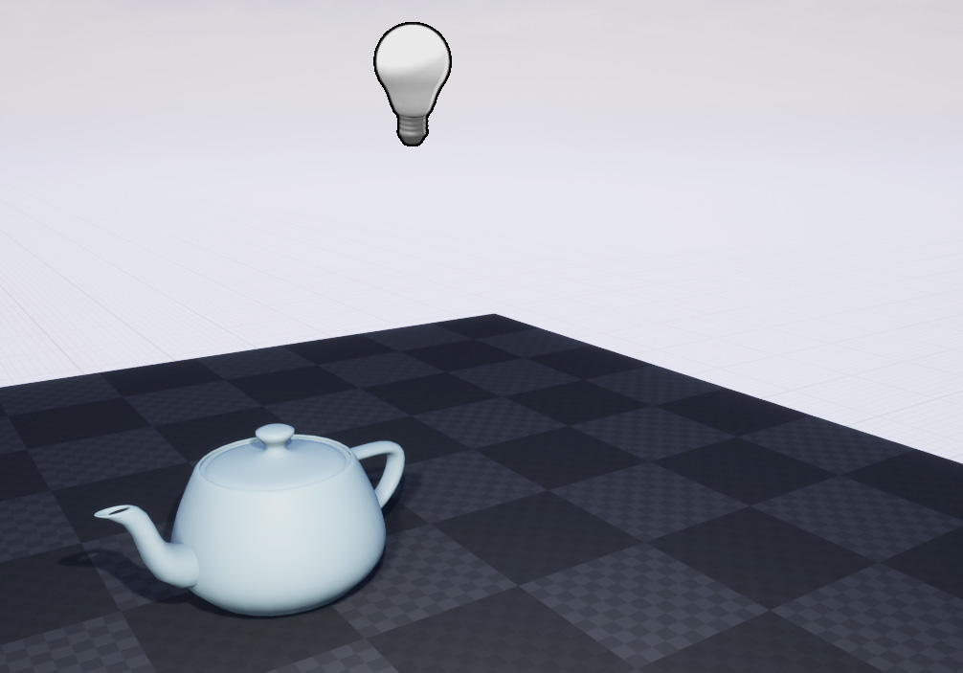
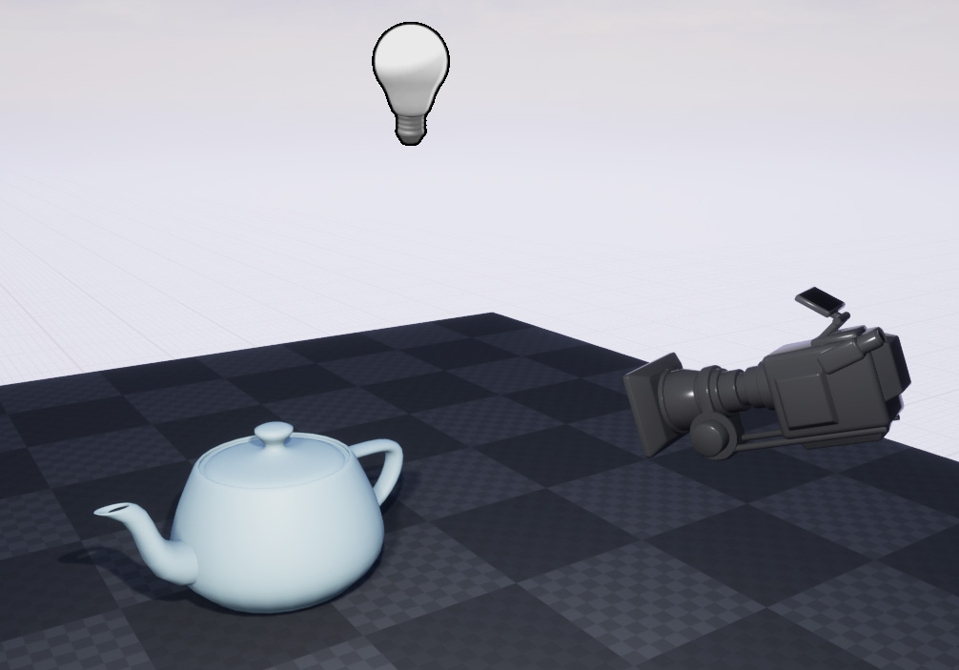
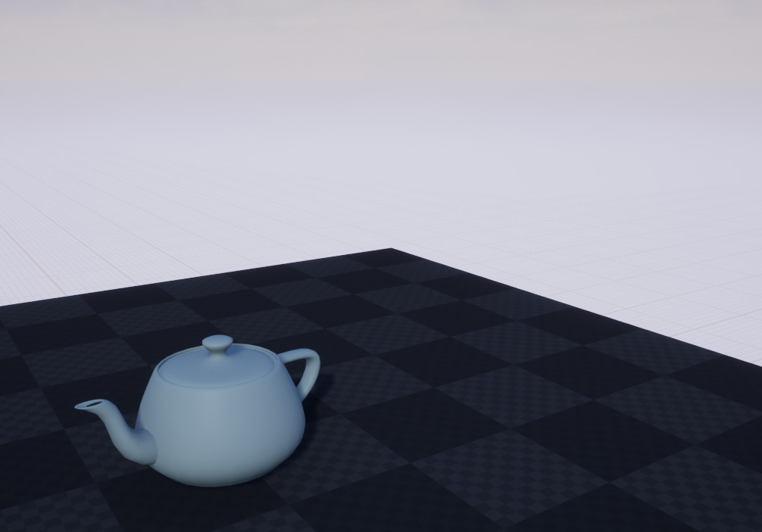
Required components of a 3D Scene
Meshes
Lights
Camera

Slide 20
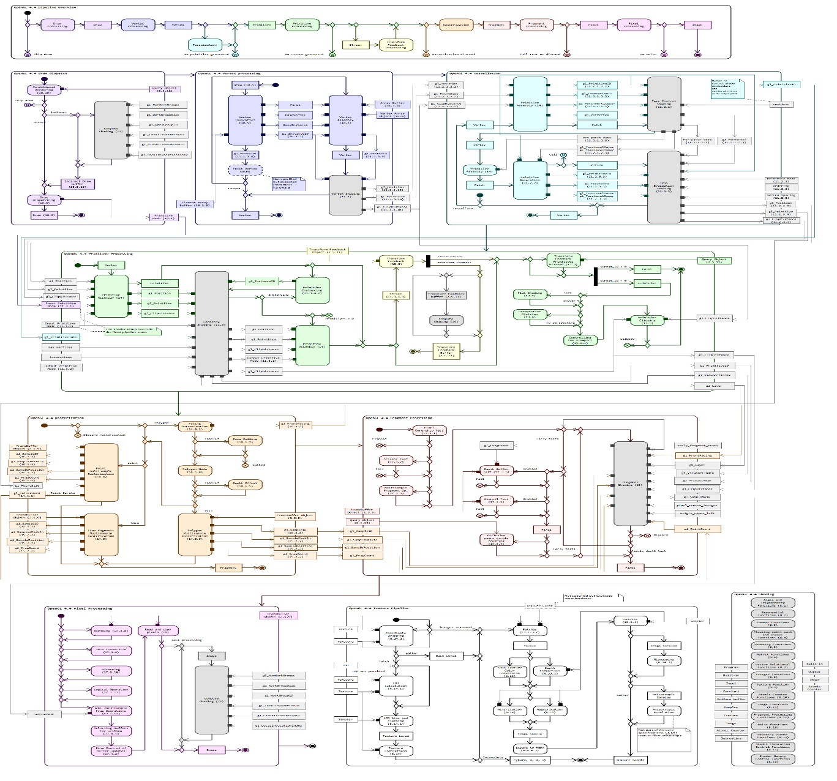
How 3D Images are Generated
The Graphics Pipeline:
Each box in this flowchart is an operation
Some operations are performed millions of times per image
Many operations performed in parallel
Pipeline runs end to end 30-60 times per second or faster

Slide 21
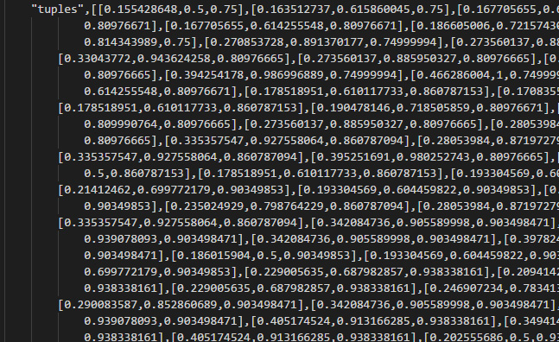
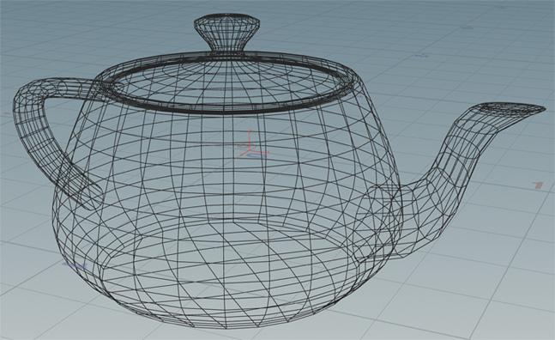
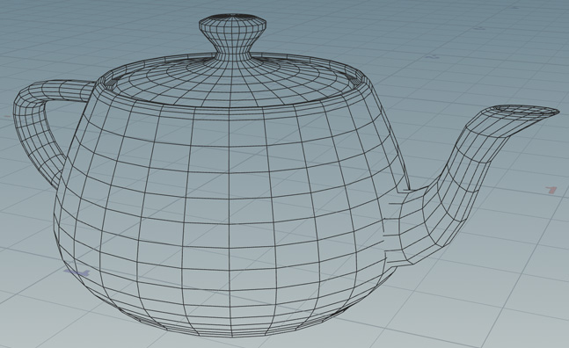
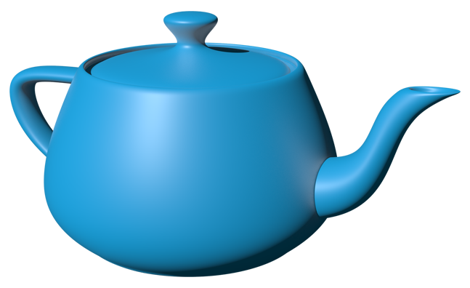
The Graphics Pipeline Simplified
Models and
Shader Programs
are loaded
Vertex Shader
sets up object
in the scene
Occluded geometry is discarded (clipping)
Fragment Shader generates pixels

Slide 22
The Graphics Pipeline is implemented in hardware
Hardware has wildly different architectures and capabilities
It’s very difficult to program hardware directly
It’s nearly impossible to support multiple architectures directly
Need a library or Application Programming Interface (API) to make it easy to write 3D applications across multiple hardware implementations

Slide 23

The Solution
OpenGL, Open Graphics Library, is an API introduced in 1992 to enable developers to take advantage of graphics hardware without having to know the details of the hardware architecture

Slide 24
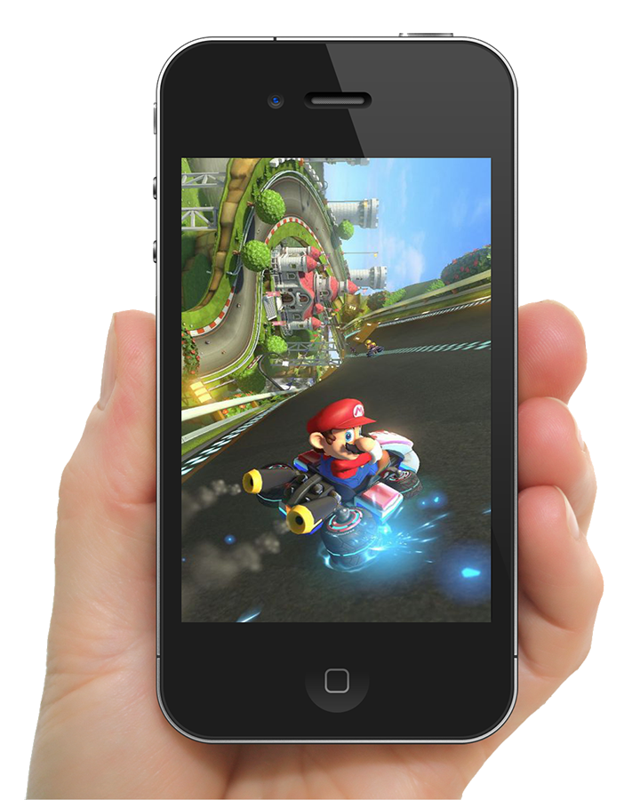
Post 2007, the proliferation of broad band connected mobile devices with graphics specific hardware demands a solution for 3D graphics delivered via the web

Slide 25

The Solution
WebGL, Web Graphics Library, is an API based on OpenGL which enables developers to produce hardware accelerated 3D graphics on the web

Slide 26
WebGL is not JavaScript
WebGL is language independent and built into all modern internet browsers
We will use a framework called three.js to leverage WebGL through JavaScript

Slide 27
A Few Words on three.js
One of dozens of frameworks for 3D on the web
Most widely adopted framework for 3D
Will be viable for years to come
Higher performance, more capable technologies are on the horizon.
Visit threejs.org for inspiration

Slide 28
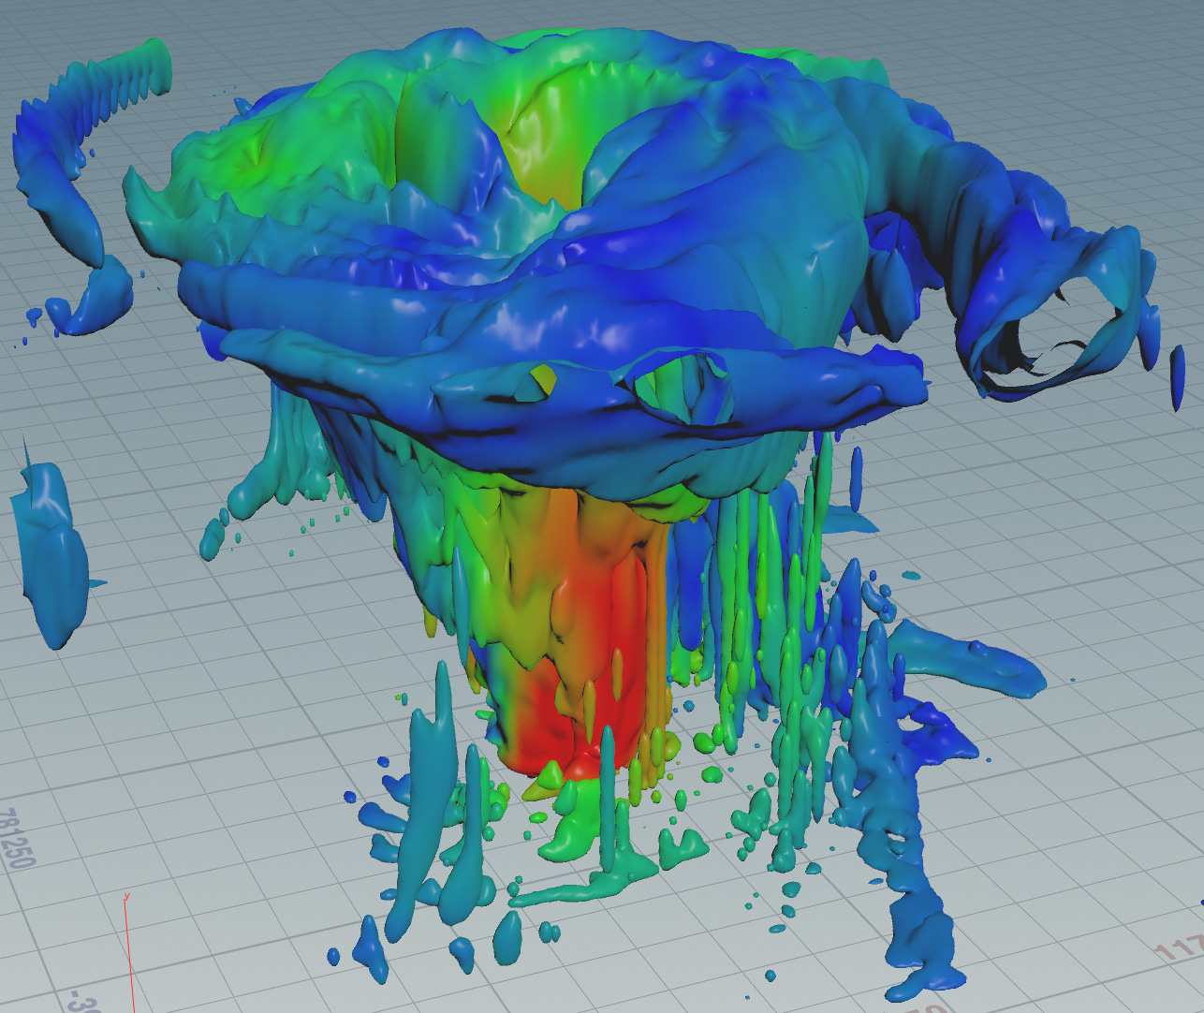
Visualizing Hurricane Katrina
Data processed in Paraview
Converted to model
Wind magnitudes normalized and applied to vertices as color
Data smoothed and decimated
Exported to Collada, a file format that can be loaded with three.js
Data acquired from http://www.cis.umassd.edu/~dkoop/cis467/assignment5.html

Slide 29
Visualizing Hurricane Katrina
Our Objectives:
Display this model in a browser
Add controls to interact with the model
Data acquired from http://www.cis.umassd.edu/~dkoop/cis467/assignment5.html

Slide 30
What Tools Do We Need
An editor
A browser that supports WebGL
three.js source files
Microsoft Visual Studio Code - code.visualstudio.com
Mozilla Firefox – mozilla.org
three.js Framework - threejs.org

Slide 31
Project files for this Workshop
github.com/nuitrcs/IntroToWebGLWorkshop
Project files are located in the WebGLProject directory

Slide 32
Project Files
index.html – our working file
WorkshopFinal.html – the completed project
WorkshopTutorial.js – A JavaScript file containing all the code and lengthy comments explaining the script that loads and displays our data.
OnlineResources.pdf – A PDF file contains links to various online resources for creating WebGL visualizations.

Slide 33
Project Files
Data Folder:
Katrina.dae – Model we will load and visualize
three Folder:
ColladaLoader.js – Model loader library
OrbitControls.js – Control library
three.js – Core three.js library

Slide 34
index.html is our work file
This is a minimal HTML framework
<!doctype html>
<html lang="en">
<head>
<meta charset="utf-8">
</head>
<body style="margin: 0;">
<!-- Include JavaScript libraries here -->
<script>
// Our script goes here
</script>
</body>
</html>

Slide 35
We will be adding code in the green commented areas
<!doctype html>
<html lang="en">
<head>
<meta charset="utf-8">
</head>
<body style="margin: 0;">
<!-- Include JavaScript libraries here -->
<script>
// Our script goes here
</script>
</body>
</html>

Slide 36
The remainder of this workshop will be interactive
Please open index.html for editing
Open WorkShopTutorial.js to cut and paste code snippets as we work through the tutorial

